Slide 1
Welcome Back!
Q: Why use SAM Learning this year?
A: It benefits your learners - and saves you time!
Find Gaps and Fill Gaps.
Reduce your workload.
Be confident in a proven system.
Get all the support and training you need.
Notes:
Thousands of high quality revision and assessment resources are ready for you to use - across a large range of subjects.
The work is marked for you - reducing your workload.
You can create your own intervention groups to monitor or set work to targeted learners.
The progress and usage reports quickly let you know how well your learners are doing.
We will provide you with all the support and training you need.
The Fischer Family Trust has proven that regular use of SAM Learning boosts GCSE results.

Slide 2
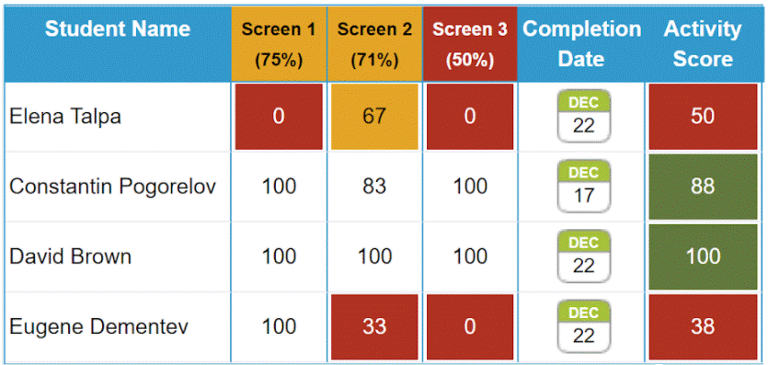
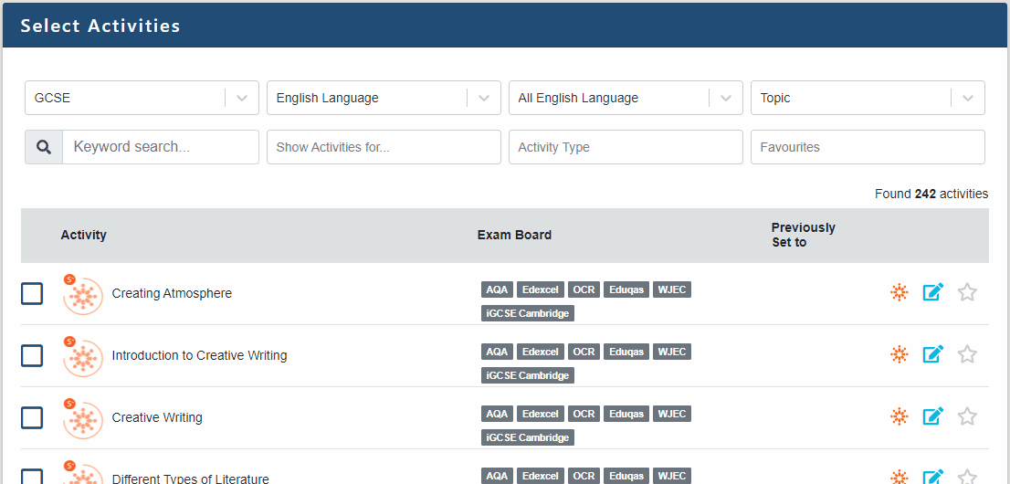
What’s new…?
In the last year we...
Helped you through Lockdown with unbroken service and swift support.
Added Question Level Analysis Reports.
Improved the task setting interface.
Identified New and Key Content for you.
Added more resources every month, including: Diagnostics and GCSE Exam Essentials for core.
Launched the CPD Centre and improved the Message Board.
Linked to your Homework Setting software.
Notes:
In case you have missed our newsletters and message board announcements last year, here’s a brief summary of what we did.

Slide 3
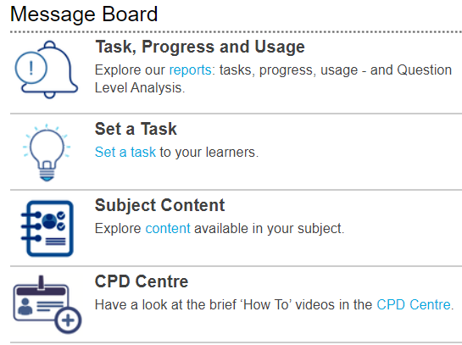
What’s coming…?
Right now we are working on...
Converting activities to run better on small-screen devices.
Simplifying that initial Teacher ‘learning overhead’ to help you to get started even quicker.
Focussed Support on the problems that affect Schools, such as:
Year 7 Baselining and Intervention
Subject-Level Support
...and lots of other exciting developments that we’ll announce when they’re on their way!
Notes:
GroupCall for Teachers will be up and running for September - just as we have always linked your learners to classes - now we can link your teachers to their classes - which makes getting started even easier.
QLA will give teachers an overview of how well learners have done in different parts of tasks - allowing you to respond to their weak areas with targeted teaching.

Slide 4
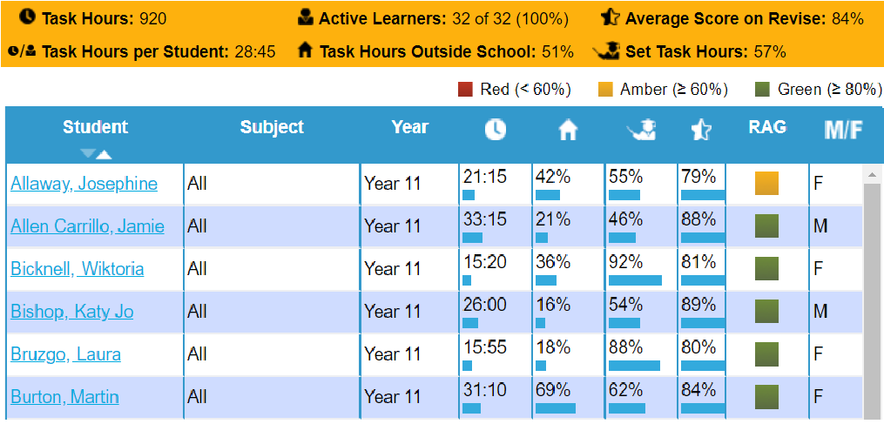
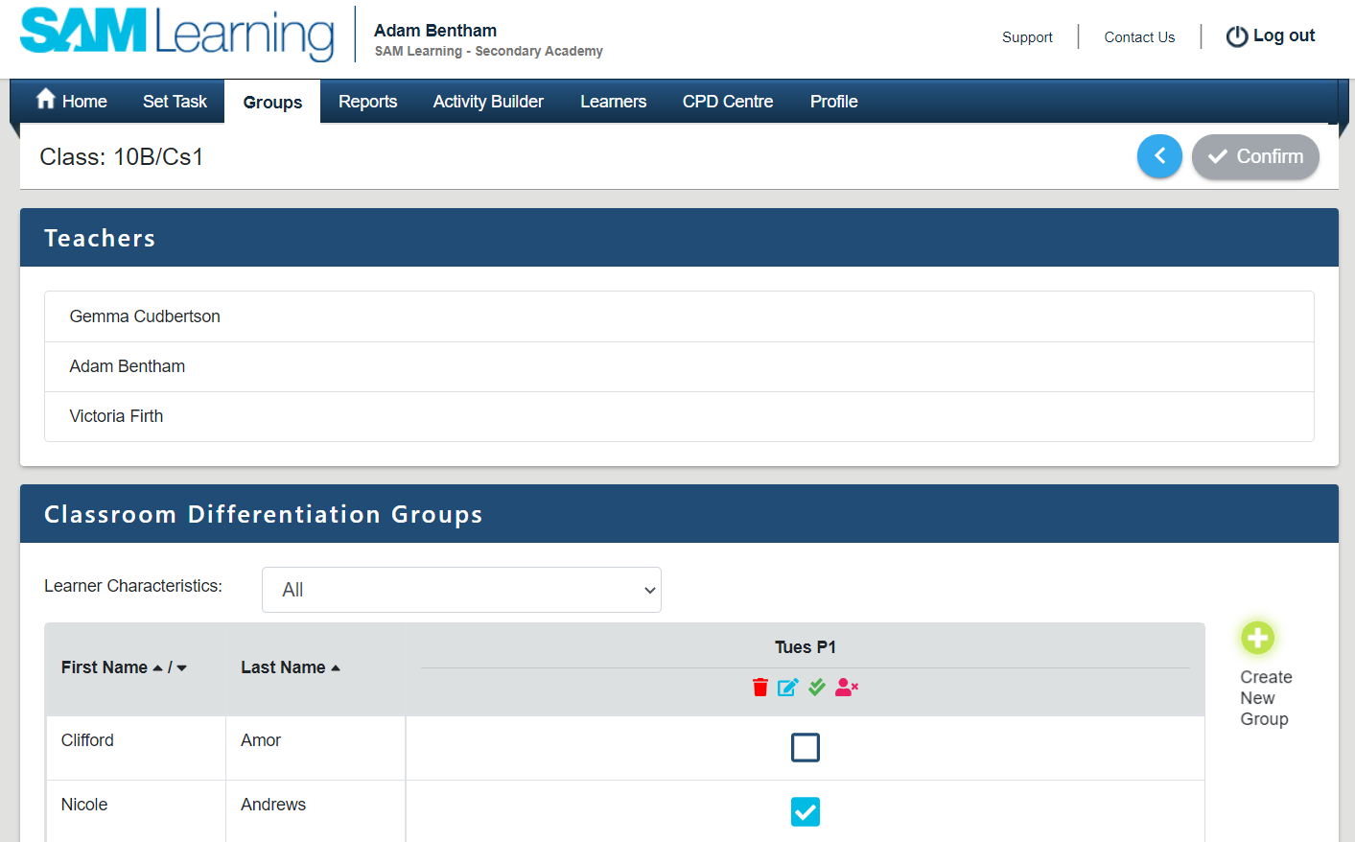
3 points for Teachers
SAM Learning has thousands of activities - the system will mark them, email the scores - and identify gaps!
You can set up your own Classroom Differentiation Groups - to target underperforming learners.
You can personalise many of our activities… or even build your own.
Notes:
The resources are ready there for you - and auto-marking will help you to manage your workload.
If you think about any one of your classes, you might identify a handful of learners who would benefit from a little more focussed attention - make a group of these pupils.
SAM Learning’s Activity Creator is a little like powerpoint… you can create and edit content or question pages - and add your own images or sound clips - and link to YouTube and other websites.

Slide 5
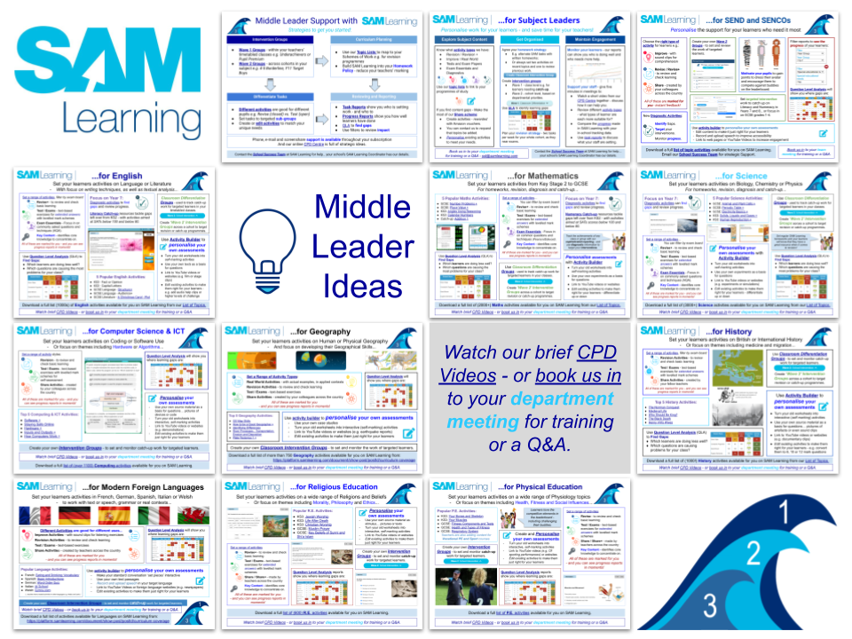
3 points for Middle Leaders
Think Intent, Implementation, Impact:
You can plan SAM Learning activities into your schemes of work.
You can include SAM Learning in your homework and intervention policies (Wave 1 and 2 Groups).
You can monitor and review learner performance - by task, progress or usage.
Contact your School Success Manager to book us into a Team Meeting.
Notes:
Middle leaders can use SAM Learning to support your organisation and development plan:
- there are topic lists available from our home page
- you can make your own groups for monitoring or intervention
- our market-leading reporting suite provides great summaries of learner achievements
- resources for middle leaders are available on the support pages

Slide 6
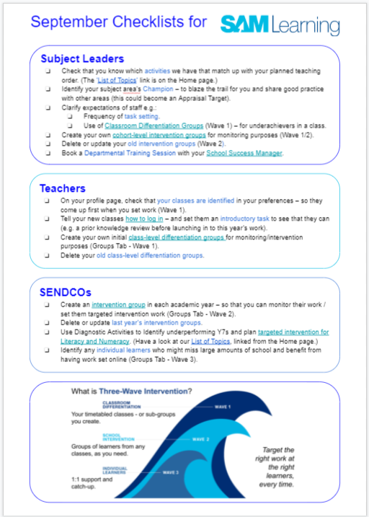
Get started quickly
New staff - if you haven’t received a registration email, speak to your school’s SAM Learning Coordinator.
Existing Staff - refer to the September Checklists (your SAMCo has a copy, or find it online).
For help, use our CPD Centre and support pages.
Notes:
New Staff - get yourself registered - why not have a go at setting a task for one of next week’s classes?
This year, we have also produced brief checklists to help you to get up and running quickly.
Look to our support pages for useful “how to” guidance.
Thank you - have a good year.

