Slide 1
Subject Leader Workshop
How to get the most from SAM Learning
for your Department, Teachers and Learners
Notes:
Welcome to SAM Learning’s Subject Leader Workshop - strategies to help you to get the most for your department from SAM Learning.
This workshop should take between thirty minutes and an hour, depending on the depth of your reflections or discussions.
It will help if you are at a computer and logged in to SAM Learning for this workshop - if possible, log in now so that you can refer to the website as the training progresses.
If you can also access your departmental folders / files, that will be useful (but not essential).

Slide 2
Subject Leader Workshop - get the most out of SAM Learning:
Clarify your Intent:
Understand how our activity topics map to your curriculum.
Straightforward Implementation:
Include SAM Learning in your Homework Policy - a high quality way to reduce your teachers’ burden.
Implement “Three-wave” intervention strategies to support your learners - including disadvantaged and SEND.
Monitor Impact:
Use our sophisticated analytics suite to check understanding systematically and report back to key school leaders.
Notes:
There are three main parts to this workshop:
Firstly we will look at “intent” - specifically how you can match up our activities with your schemes of work.
Then we will think about “implementation” - a couple of areas of departmental organisation: integrating with your homework policy and supporting intervention.
Finally we will consider “impact” - using our reporting suite to review achievement and support evaluation.
Along the way… there will be opportunities for you to discuss and reflect upon these areas - in particular how they can help you in your daily work.

Slide 3
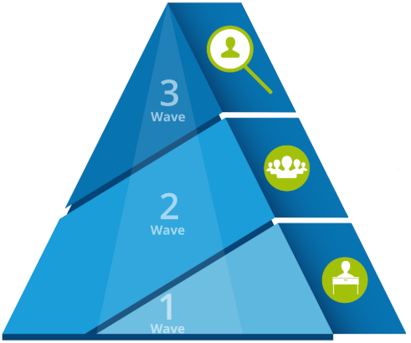
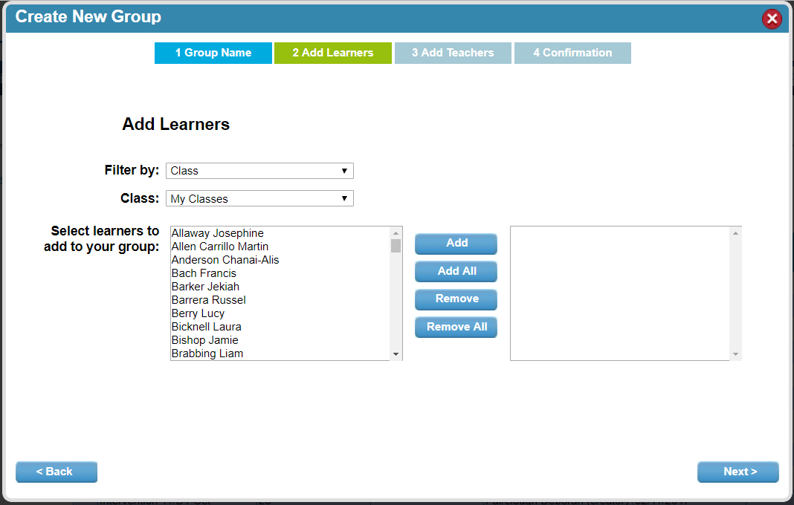
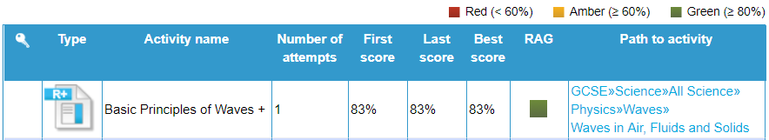
Subject Leader Support
School Success Team
Introduction
Curriculum
Homework
Intervention
Reporting
Biscuits
Overview: How can Subject Leaders get the most from SAM Learning?
Exit
1. Know what’s here
2. Use groups to target work
3. Review progress on reports
1a. Look at our topic lists, linked from our home page, or here:
2a. Identify key learners - and link to teachers.
https://platform.samlearning.com/document/show-post/postId/curriculum-coverage
3a. Usage reports show you which learners / subjects are active.
3b. Progress reports let you know how well learners or groups are doing.
1b. Identify the key topics for your clases.
2b. Set and monitor carefully chosen work.
1c. Set 2 or 3 activities a week in the run-up to examinations.
2c. Edit the groups as performance changes.
3c. Task Reports allow you to see which tasks have been set by teachers - and how learners did.
Notes:
Here is a one-page overview of the sorts of things that most Subject Leaders will be interested in.
This will make the most sense to you if you are an experienced SAM Learning user - but don’t worry if you aren’t, as we will go through each element.

Slide 4
Before we begin:
Do you know how to...
Find out what activities we have on different topics?
Create your own intervention groups - for monitoring or setting work to?
Use our Progress / Tasks reports to find out how well your learners are doing?
Notes:
Before we begin, it might help to think about your starting point. Do you know how to…
Find out what activities we have on different topics?
Create your own intervention groups - for monitoring or setting work to?
Use our Progress / Tasks reports to find out how well your learners are doing?
If you answer “no” to any of these, you have three main avenues of support: your school’s SAM Learning Coordinator, our helpful support pages online, or our online cpd.

Slide 5
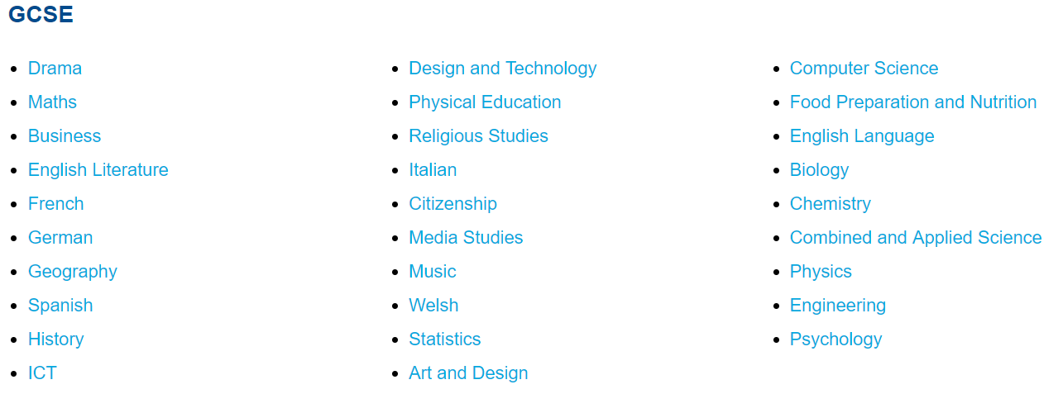
Subject Leader Support
School Success Team
Introduction
Curriculum
Homework
Intervention
Reporting
Map your curriculum - to clarify your intent
Exit
1. Download the topic lists
2. Identify activities for years
3. Paste these into your SoW
Look at our topic lists via the link on our home page:
https://platform.samlearning.com/document/show-post/postId/curriculum-coverage
If you find a gap in our content - fill it with your own Share Activity - or request its addition to our Amazon Rewards scheme.
Notes:
As a subject leader, your first question is “what content have you got for us?” The simple answer is: over 11,000 activities - but you will want specifics.
On our home page, you can find a link to “topic lists” - you can download a spreadsheet for each subject, for each key stage. These can be filtered, sorted and highlighted quickly to help you to identify key content for each of your year groups.

Slide 6
Subject Leader Support
School Success Team
Introduction
Curriculum
Homework
Intervention
Reporting
Map your curriculum - to clarify your intent
Exit
1. Download the topic lists
2. Identify activities for years
3. Paste these into your SoW
Which activities are useful to review prior work at the start of a topic?
Which activities are suitable for regular homeworks?
Which activities are suitable for a revision programme, later on?
Notes:
As you look through the topic lists for your subject, you could think which topics…
Are good for reviewing basics
Are good checks of knowledge for regular homeworks
Could be combined into a staged revision programme in the run up to exams.

Slide 7
Subject Leader Support
School Success Team
Introduction
Curriculum
Homework
Intervention
Reporting
Map your curriculum - to clarify your intent
Exit
1. Download the topic lists
2. Identify activities for years
3. Paste these into your SoW
You could copy the list of relevant SAM Learning tasks for a topic into the start of each section...
...or note tasks as possible homeworks to prepare for, or follow up from, specific lessons.
Revision plan… set your pupils key tasks in the run-up to exams.
Notes:
Think about the next topic you are due to teach… you can quickly copy (ctrl-c) and paste (ctrl-v) the activity titles into the appropriate positions in your Schemes of Work.
Why not identify two or three activities that would be good to set as revision homework before each test?
(This is a good task to share out amongst your colleagues - so that everyone can see what is being put together.)

Slide 8
Over to you:
Get the spreadsheet of activities in your subject from our “List of Topics” Page.
Highlight the activities that could be useful in your different topics / units of work.
Start to copy and paste the names of these activities into the appropriate places in your Schemes of Work (this will especially support non-specialist teachers).
Notes:
This workshop is going to pause in a moment.
I am going to suggest that you spend five to ten minutes thinking about how you can map our content for your subject.
Before going any further, either open up one of your Schemes of Work documents or start up a new file on the computer to hold your draft work for now. Then:
Get the spreadsheet of activities in your subject from our “List of Topics” Page.
Highlight some of the activities that could be useful in one of your topics / units of work.
Start to copy and paste the names of these activities into the appropriate places in your Schemes of Work (this will especially support non-specialist teachers).
In a few minutes, when you think you can see how this can be done, move on to the next section.

Slide 9
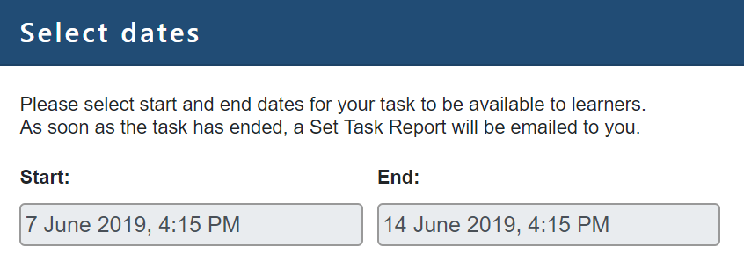
Subject Leader Support
School Success Team
Introduction
Curriculum
Homework
Intervention
Reporting
Build SAM Learning into your Homework Policy
Exit
1. Agree your frequency
2. Plan progress tracking
3. Agree monitoring schedule
Alternating SAM Learning tasks with written homeworks gives variety and helps to reduce teacher workload.
E.g. plan to set two activities every other week (that’s about 30 mins work).
Beware of setting too many tasks at once - most pupils respond better to manageable amounts.
Notes:
As a subject leader, you will appreciate the need to agree and clarify expectations of your staff. We are going to split this section into two parts: firstly how SAM Learning can become part of your homework policy - setting high quality review tasks, while at the same time reducing teacher marking workload. After that, we will look at how you can create your own sub-groups for intervention purposes.
So, one of the first things to decide is: “how often will you set SAM Learning tasks”?
(At this point, I will remind you that “task” is one setting of one or more “activities” to learners.)
Let me start by proposing that you set a task of two or three activities every other week. That’s regular, allows for e.g. written homeworks in-between - but reduces the marking burden on your colleagues.
How do you feel about this proposition? Of course, you should tweak it to match your departmental needs.

Slide 10
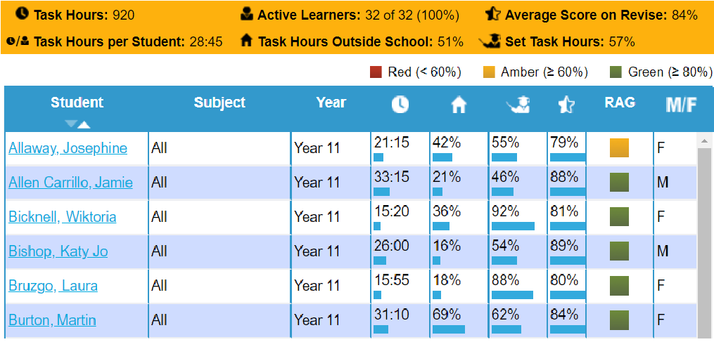
Subject Leader Support
School Success Team
Introduction
Curriculum
Homework
Intervention
Reporting
Build SAM Learning into your Homework Policy
Exit
1. Agree your frequency
2. Plan progress tracking
3. Agree monitoring schedule
SAM Learning will mark most activities for you and email the scores… and monthly overviews.
Online progress reports can be filtered by class or intervention group - and to set date ranges.
Refer to your school reporting schedule / data collection points - to identify when to review SAM Learning progress data.
Notes:
Having thought about how often to set tasks… you will want to consider how often to access and review progress.
(Bear in mind, of course, that the scores from every set task are emailed to your teachers when the task end date is reached.)
You will most likely have two or three data collection or reporting points in each year - why not plan to review SAM Learning progress reports the week before?

Slide 11
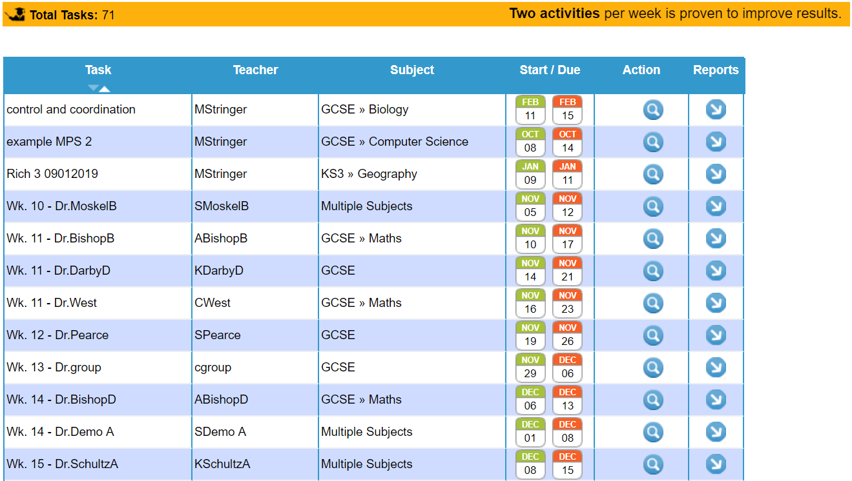
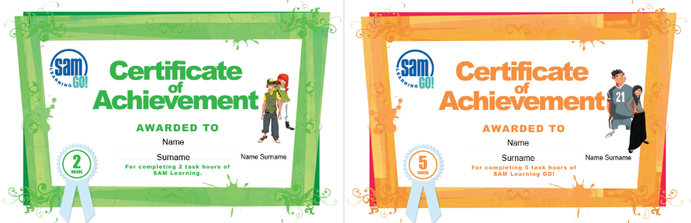
Subject Leader Support
School Success Team
Introduction
Curriculum
Homework
Intervention
Reporting
Build SAM Learning into your Homework Policy
Exit
1. Agree your frequency
2. Plan progress tracking
3. Agree monitoring schedule
Set expectations with your staff e.g. A task each fortnight means 5-6 tasks a term per class.
Why not give a small prize to your top-setting teacher?
Notes:
Any system needs to be monitored - especially new initiatives.
Discuss with your colleagues how many tasks you think you will each set in, say, half a term. (You can share the tasks report with them in future subject meetings.)
Teachers like recognition as much as pupils do - why not offer up a small prize (like a bar of chocolate… or an apple) to the teacher who sets the best number of tasks?

Slide 12
Over to you:
How often would you like your teachers to set SAM Learning tasks?
How could this be written into your homework policy (demonstrate your intent)?
When you look at the Tasks Report, how many tasks would you expect to see set in each half term?
Notes:
We will pause again in a moment to think about this section.
Before addressing these questions, have you got a copy of your subject’s homework policy available? It will help to have it open - you could annotate today’s thoughts in it.
What are your answers to these questions:
How often would you like your teachers to set SAM Learning tasks?
How could this be written into your homework policy (demonstrate your intent)?
When you look at the Tasks Report, how many tasks would you expect to see set in each half term?
When you have jotted down what you think are answers that you could discuss with your colleagues, please move onto the next section.

Slide 13
Subject Leader Support
School Success Team
Introduction
Curriculum
Homework
Intervention
Reporting
Plan your intervention strategies
Exit
1. Create intervention groups
2. Target work to these groups
3. Review progress on reports
Groups can be made for monitoring or setting tasks.
As a subject leader, you can create groups to monitor specific learners across a cohort.
Teachers in your subject can make their own groups of learners for intervention.
Notes:
Next we’re going to move on to talk about intervention - by which I mean, “identifying which pupils need a little extra… and then doing something about it”.
One of the most useful features in SAM Learning is the ability to create your own “Classroom Intervention Groups” to be used for monitoring or setting tasks to a sub-group of learners. This is done from the “Groups” tab.
For example, your teachers can create dynamic catch-up groups for learners who underachieve in a test - extra tasks can be set to these groups to help them to catch up with the rest of the class.
As a subject leader, you can create groups across the cohort for the purpose of monitoring, for example pupil premium learners in your subject.

Slide 14
Subject Leader Support
School Success Team
Introduction
Curriculum
Homework
Intervention
Reporting
Plan your intervention strategies
Exit
1. Create intervention groups
2. Target work to these groups
3. Review progress on reports
Set intervention work from the previous year or Key Stage to strengthen foundations.
Set extra tasks to underperforming learners to help them to catch back up.
Keep absent individuals up to speed - whether off ill, on holiday or educated off-site.
Notes:
Teachers are endlessly creative - you can use these groups any number of ways:
Review of the previous year’s work for pupils who performed poorly in the end of year examinations.
Keep an eye on pupils who regularly miss lessons - and set them a programme of work.
Set challenges to teams of learners.
Monitor a specific demographic sub-group of pupils, such as pupil premium or those who under-achieved last year.

Slide 15
Subject Leader Support
School Success Team
Introduction
Curriculum
Homework
Intervention
Reporting
Plan your intervention strategies
Exit
1. Create intervention groups
2. Target work to these groups
3. Review progress on reports
Task reports show how many tasks teachers have set. You can filter this by subject and teacher.
Progress reports show you how well learners have done - RAGged for easy reading.
Usage reports let you compare your subject usage to others, as well as comparing year groups.
Notes:
In order to identify and track the progress of these groups, you will want to use our reporting suite. You will find three main types of report available:
Task reports, summarising tasks set by each teacher or to each group. These reports are dynamic - you can drill down into each task to see how well learners have performed.
Progress reports, giving percentages and time spent on SAM Learning by learners. These can filter in many different ways to report on the learners, subjects and date ranges you are interested in.
Usage reports show you how much different year groups and subjects are using SAM Learning. (How does your subject usage compare to to others’?)

Slide 16
Over to you:
How would you like your teaching staff to use their own classroom intervention groups?
Which learners would you like to be able to monitor in each year group / cohort? Try making a draft “Classroom Intervention Group” for one of these.
Have a look at a Progress Report for the group you just made… what does it tell you about which learners need extra support?
Notes:
We will pause again now, to allow you to think about how you can use our reporting suite.
Do you have access to your M.I.S., or a recent pupil progress report? This could help you to focus your thoughts.
How would you like your teaching staff to use their own classroom intervention groups? (Which learners need a little extra?)
Which learners would you like to be able to monitor in each year group / cohort? Go to the “Groups” tab and try making a draft “Classroom Intervention Group” for one of these - right now.
Then go to the “Reports/Tasks” tab and have a look at a Progress Report for the group you just made… what does it tell you about which learners need extra support?
When you have seen how these fit together, move onto the final section of this workshop.

Slide 17
Subject Leader Support
School Success Team
Introduction
Curriculum
Homework
Intervention
Reporting
Prepare to report back to your Senior Team
Exit
1. Monitoring Meetings
2. Appraisal Evidence
3. Subject Self-Evaluation
Show your SLT Link / Line Manager that you have an organised approach.
Refer to progress data to show how well learners are engaging with your subject.
Discuss your intervention groups - how these pupils are benefitting from carefully targeted work.
Notes:
As a subject leader, you are likely to have meetings with your line-manager, where you discuss the progress of learners in your subject and the effectiveness of your interventions.
If you spend a few minutes beforehand, you can download relevant reports from SAM Learning to use as a focus in these meetings - or you can just access them online during your meeting.
Using these you can show how you have identified learners for monitoring and support - how well they have done - and lay out your next steps.

Slide 18
Subject Leader Support
School Success Team
Introduction
Curriculum
Homework
Intervention
Reporting
Prepare to report back to your Senior Team
Exit
1. Monitoring Meetings
2. Appraisal Evidence
3. Subject Self-Evaluation
Progress reports make great evidence to show the attempts you have made at intervention.
You can filter progress reports to your Classroom Intervention Groups or SDP Priorities.
Demonstrate the extra support you have given to your identified classes or groups of learners.
Notes:
You and your colleagues might also be asked to bring evidence of intervention to reviews, such as your annual appraisal meetings.
Each report that you filter to and view can be downloaded for inclusion as evidence of the extra support you have given to your pupils.
(You could possibly take a “snapshot” at each reporting point to demonstrate progress across the year?)

Slide 19
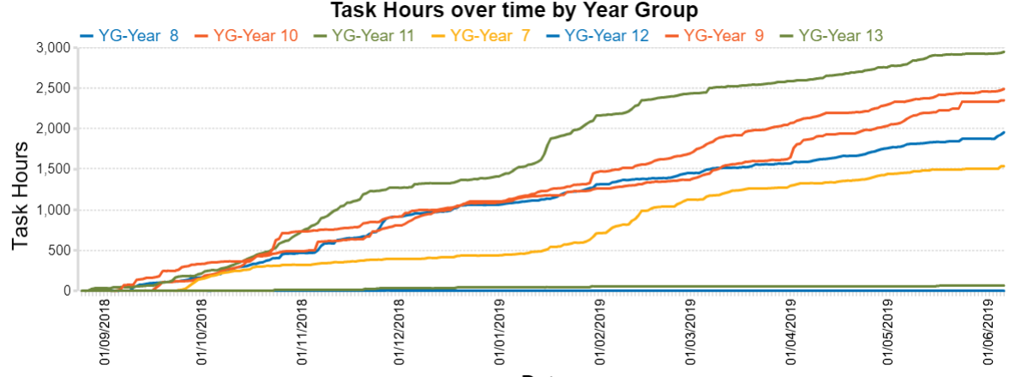
Subject Leader Support
School Success Team
Introduction
Curriculum
Homework
Intervention
Reporting
Prepare to report back to your Senior Team
Exit
1. Monitoring Meetings
2. Appraisal Evidence
3. Subject Self-Evaluation
As you review your year’s work, consider the impact of learners’ work on SAM Learning.
As you plan for next year, consider strategies for supporting key groups of learners.
When reviewing your subject’s weaker exam topics, identify more specific tasks to set.
Notes:
Many schools ask subject leaders to carry out an annual subject self-evaluation (S.S.E.)
This year, when you consider how effective your work has been, think about where SAM Learning could support you better, next year:
Are there topics where your learners need more support? Find appropriate tasks to set.
Are there groups of pupils who underperformed? Create focus groups.
Are there topic gaps - where we don’t have activities to support you? Make your own using Activity Creator…. You can find out how to do this on our support pages.
It is straightforward then to build these strategies into next year’s Subject Action or Development Plan.

Slide 20
Over to you:
What information would be valuable in meetings with your line manager / SLT link to show impact?
What information would your colleagues find useful to evidence the impact of intervention / support, when it comes to Appraisal?
How can this information inform your Subject Self-Evaluation (SSE)? (How can your SSE suggest next year’s use of Intervention Groups?)
Notes:
Some final questions for you to ponder as we finish up. Thinking about feeding back, evaluation and development planning:
What information would be valuable in meetings with your line manager / SLT link to show impact? Why not have a quick look at the progress report for one of your classes now?)
What information would your colleagues find useful to evidence the impact of intervention / support, when it comes to Appraisal?
How can this information inform your Subject Self-Evaluation (SSE)? (e.g. How can your S.S.E. suggest next year’s use of Intervention Groups or adjustments to your homework policy?)
When you have thought about these questions, continue to our conclusions.

Slide 21
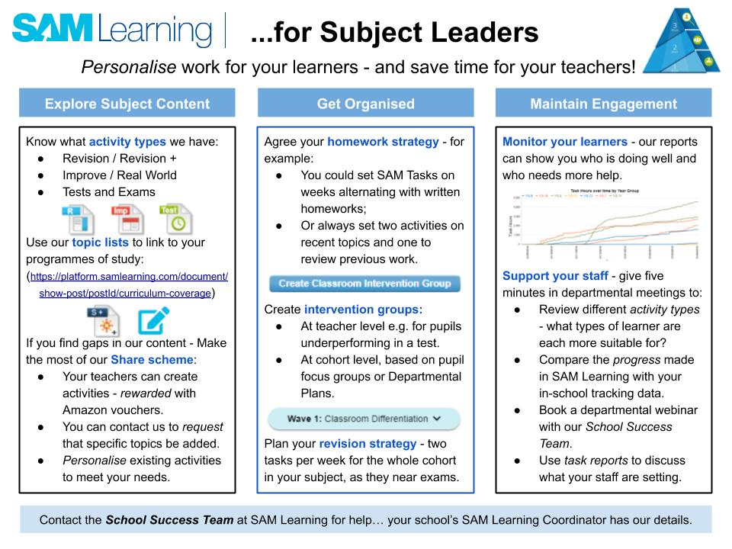
Other support for specific Middle Leaders is available:
Notes:
SAM Learning is a system which is always moving forwards, with developments to support teachers and learners in school. New support resources are being produced all the time.
For example, subject specific resources are available in the “Middle Leaders” section of our online support pages - including these single page ideas sheets, which you can download and use to focus discussion in departmental meetings.

Slide 22
SAM Learning - CPD
Thank you for participating.
We hope you found this workshop useful.
You can get more support with SAM Learning from:
Our Support Pages
YouTube: “SAM Learning Official”
Our School Success Team: SST@samlearning.com
Notes:
Thank you for working through this workshop today. We hope that you have found it useful - and that you will go away with ideas of how SAM Learning can be a highly useful element of your curriculum provision, as well as your departmental organisation.
For more support - including plenty of “How to…” advice, please go to our website support pages, online CPD or “SAM Learning Official” on You Tube.
If this workshop has made you realise that you would like more technical training from us, please contact our School Success Team and we will be happy to work with you.

