Slide 1
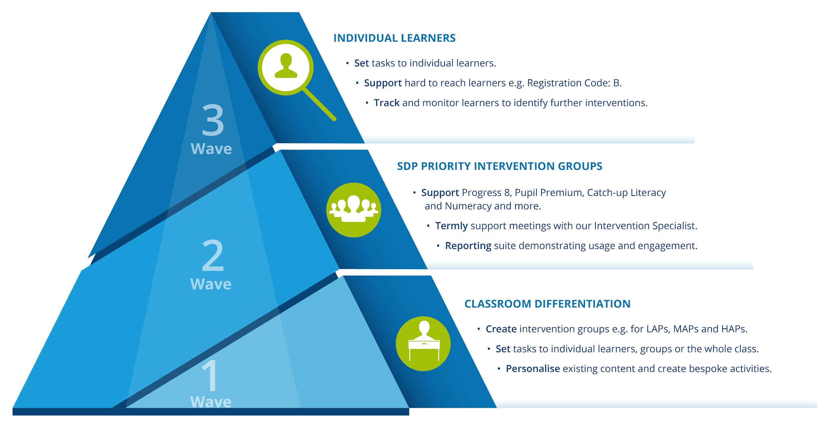

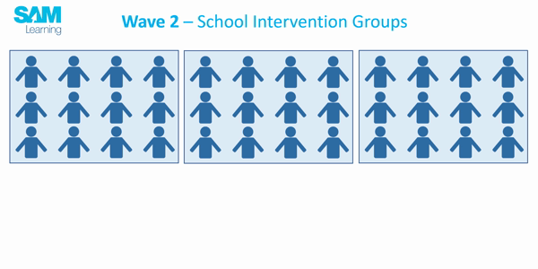
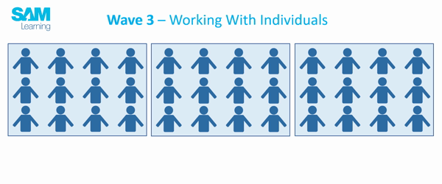
Three-wave Intervention with SAM Learning

Slide 2

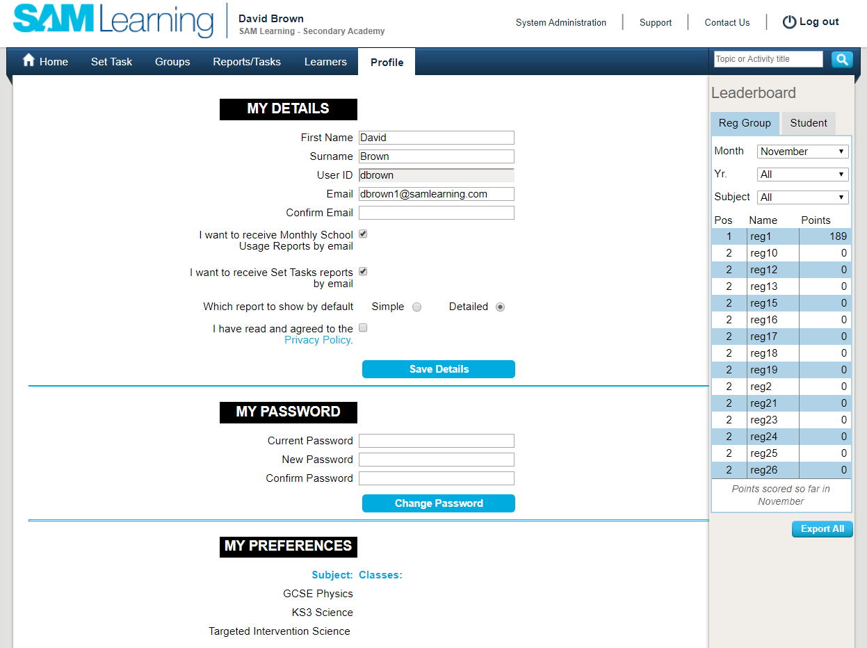
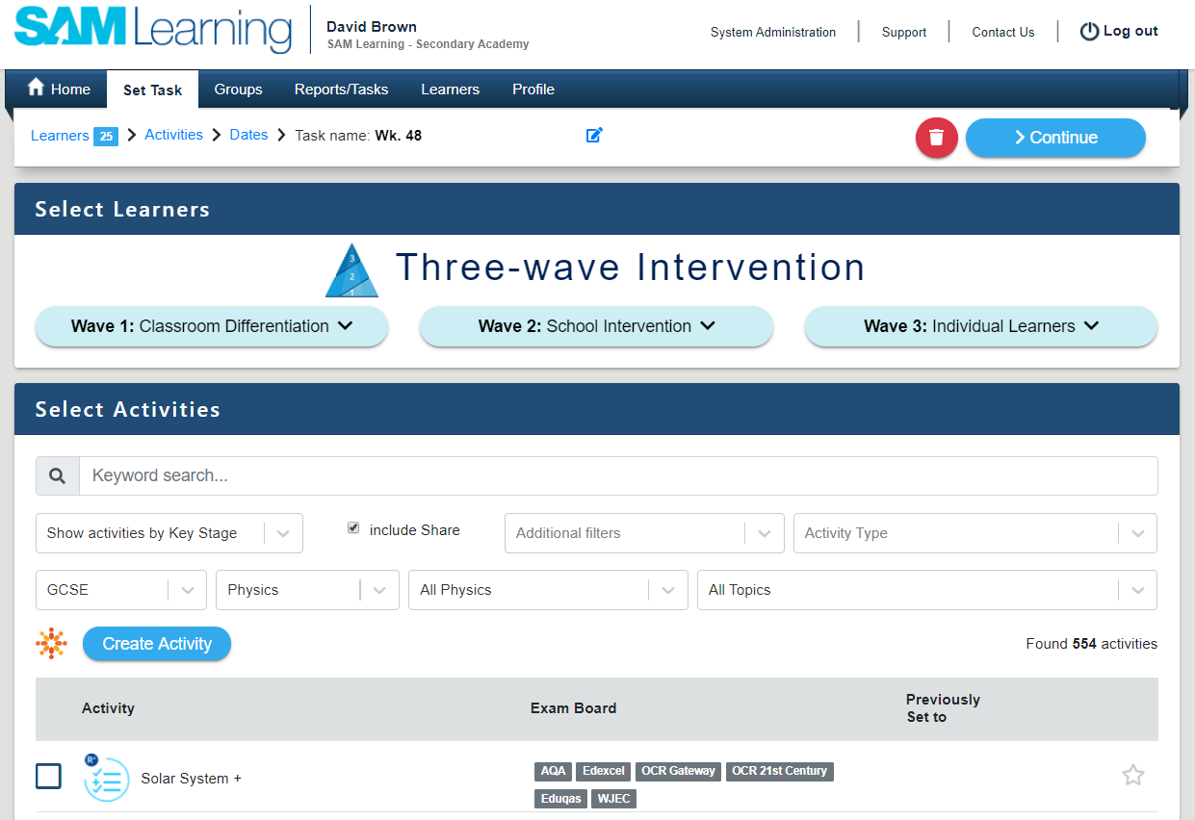
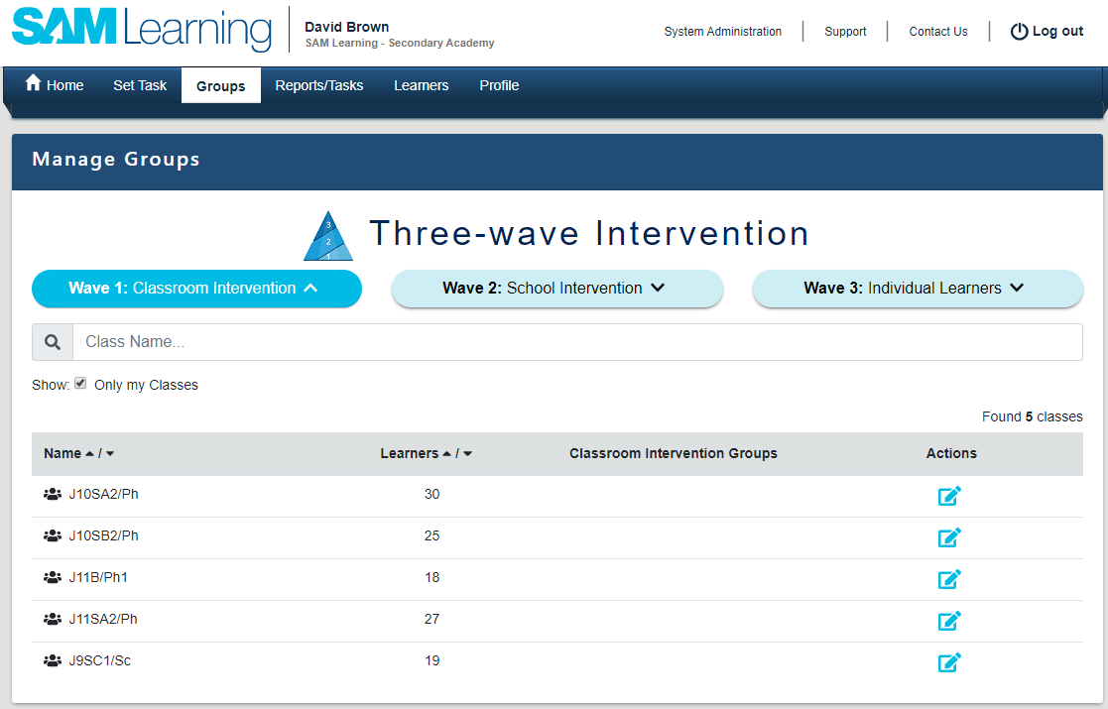

Swift Teacher Training
School Success Team
In just 15 minutes...
Exit
Set up your profile
2. Set a task to a class
3. Create a Wave 1 Group
A few minutes’ set-up will save you time every time.
Establish good learner habits - and save yourself marking time.
Focus in on key learners e.g. underperformers, pupil premium.

Slide 3
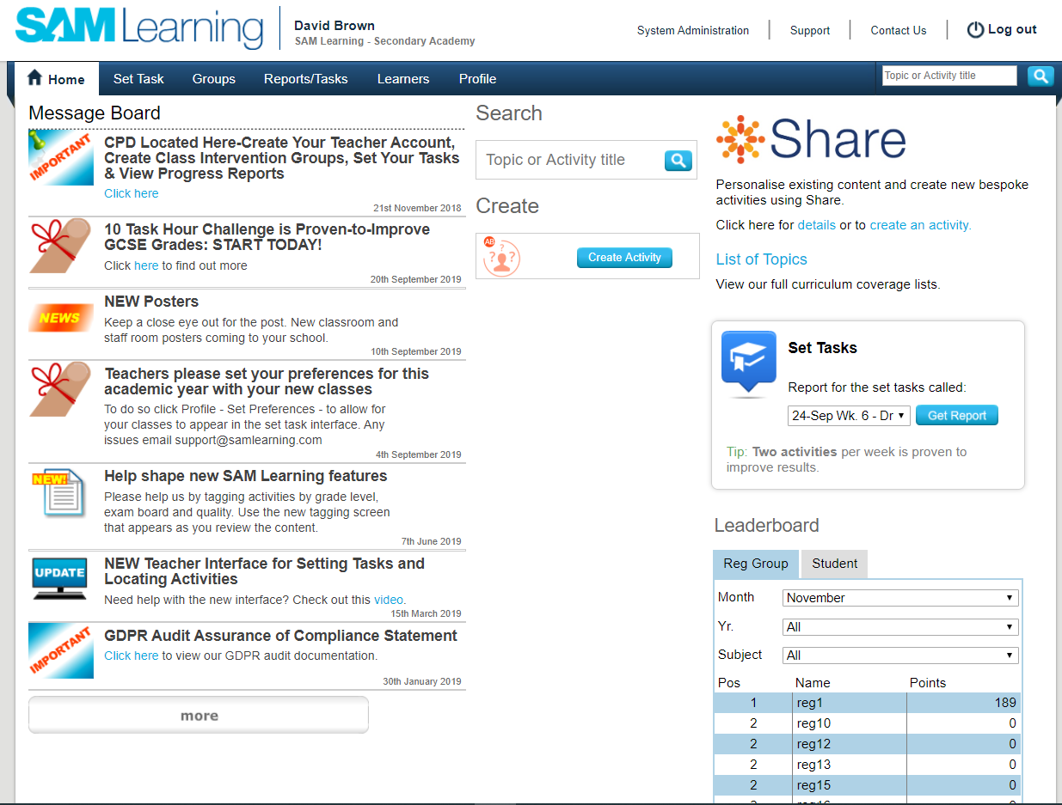
A. Setting up your Subject and Class preferences will make task setting quicker!

Slide 4
B. Go to the Profile Tab and My Preferences

Slide 5
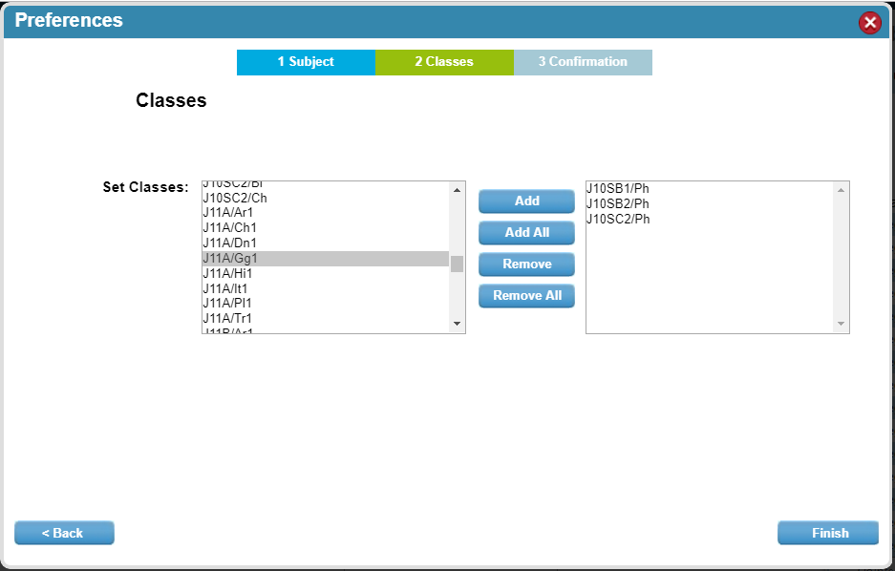
C. Identify your Subjects and Classes
…they will list first when you set tasks

Slide 6
Swift Teacher Training
School Success Team
In just 15 minutes...
Exit
1. Set up your profile
2. Set a task to a class
3. Create a Wave 1 Group
A few minutes’ set-up will save you time every time.
Establish good learner habits - and save yourself marking time.
Focus in on key learners e.g. underperformers, pupil premium.

Slide 7
Setting a task…
learners, activity, date – done!

Slide 8
B. Go to the Set Task Tab and Wave 1
Wave 1 is for Classes – or groups within a class.

Slide 9
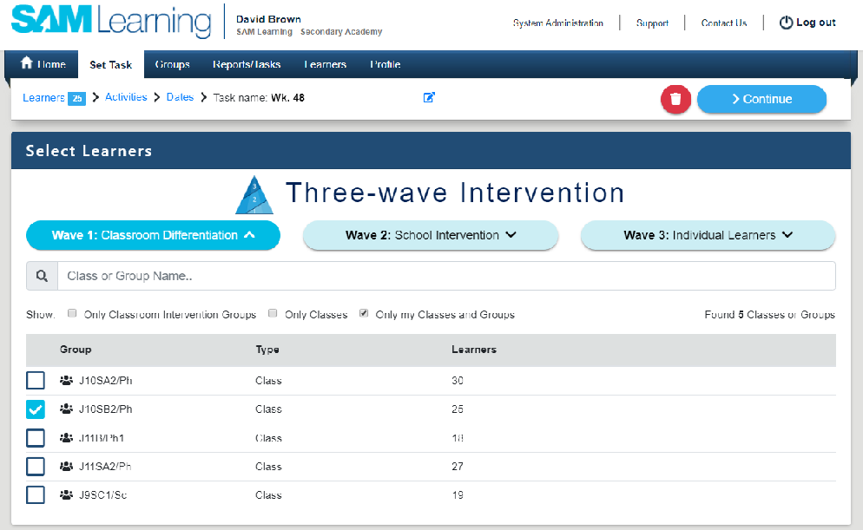
C. Select your Class
…yours list first if you have set your preferences

Slide 10
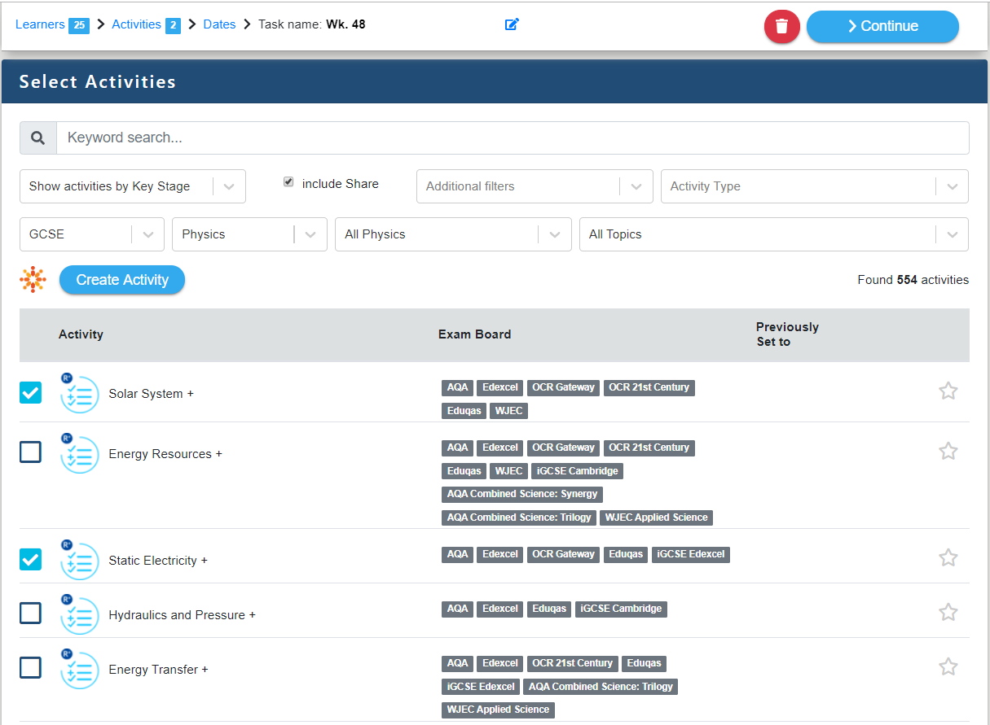
D. Select the Activities
You can check them out with a click on the icon.

Slide 11
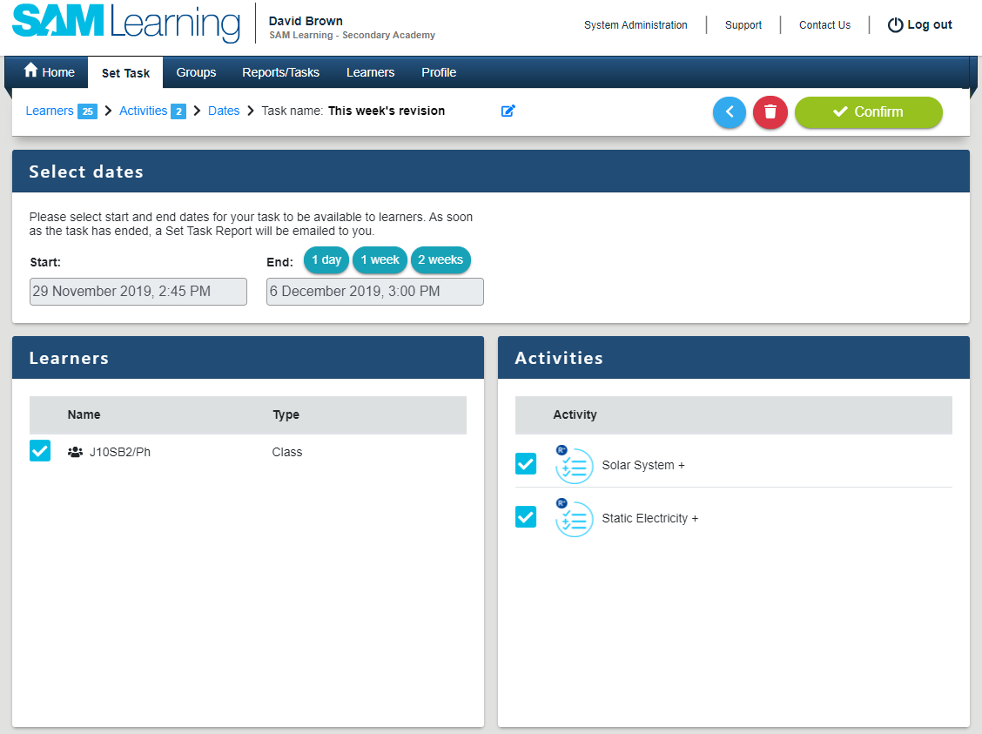
E. Choose the Date Range – and Task Name
You will be emailed the results after the deadline.

Slide 12











Initial Training
School Success Team
Introduction
Task Types
Creating
Reporting
Groups
What types of activity are available on SAM Learning?
Exit
Marked Automatically
Self-marked
Combinations
Revise Activities are used to reinforce subject-related vocabulary, with text-heavy content and drag-and-drop questions. (Revise + are more interactive.) | Improve These activities have the added advantage of sound and hints, providing additional support to the learner. | Test Test questions give learners the opportunity to write free-text answers to specific topic-related questions. The learner is provided with the mark scheme to check and score their work. | Share Teacher-created activities, shared across our community. Those that have been approved and edited by our content team are labelled as “Share +”.
Revise - Editable Revise activities that you can personalise to match your learners’ needs - edit them in our Activity Builder. | Real World Contextualised activities in which learners have to overcome problems in real-world scenarios. | Exam Practice These enable learners to develop their exam techniques. They are similar to the test questions but are timed, giving learners time-management experience. | Exam Essentials Our latest project - focused very tightly on Exam Board Specs. We have started with AQA GCSE Science.

Slide 13
Swift Teacher Training
School Success Team
In just 15 minutes...
Exit
1. Set up your profile
2. Set a task to a class
3. Create a Wave 1 Group
A few minutes’ set-up will save you time every time.
Establish good learner habits - and save yourself marking time.
Focus in on key learners e.g. underperformers, pupil premium.

Slide 14
Create a Wave 1 Group…
Target learners within your class

Slide 15
B. Go to the Groups Tab and Wave 1
Click on the Personalise Action.

Slide 16
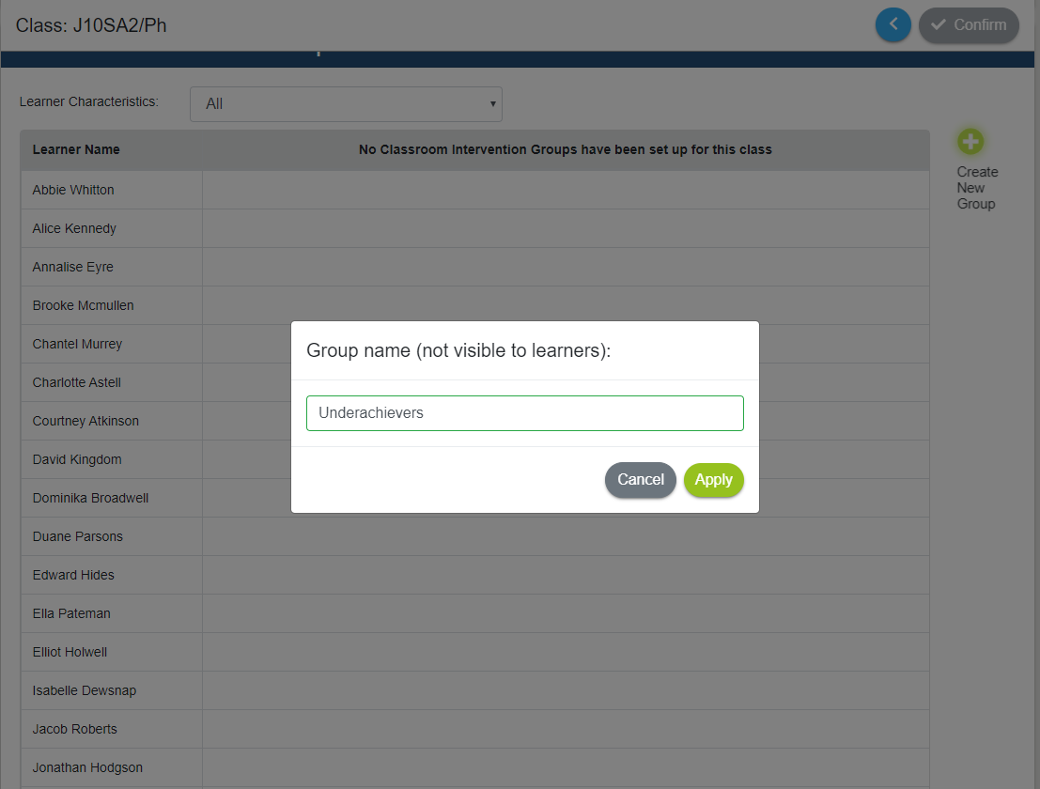
C. Create a new group
…and give your group a name.

Slide 17
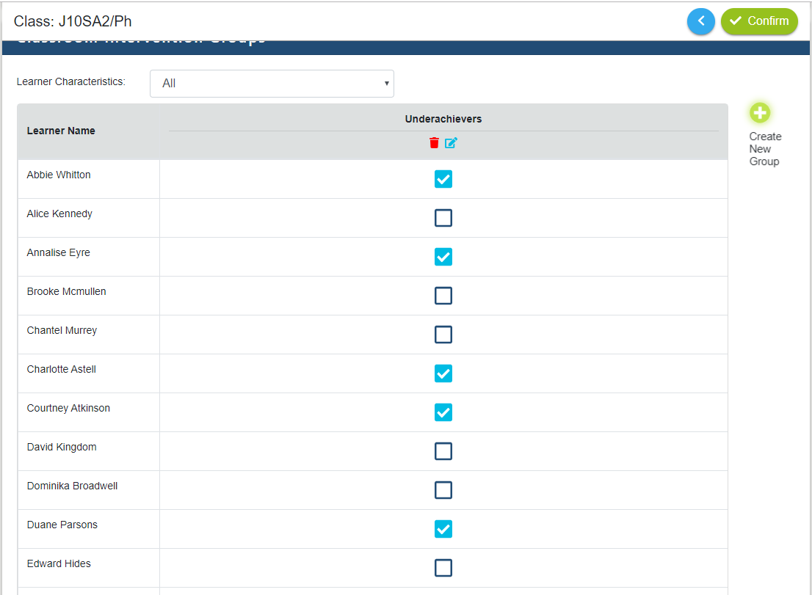
D. Select the Learners
(Learners don’t ever see that they are in groups.)

Slide 18
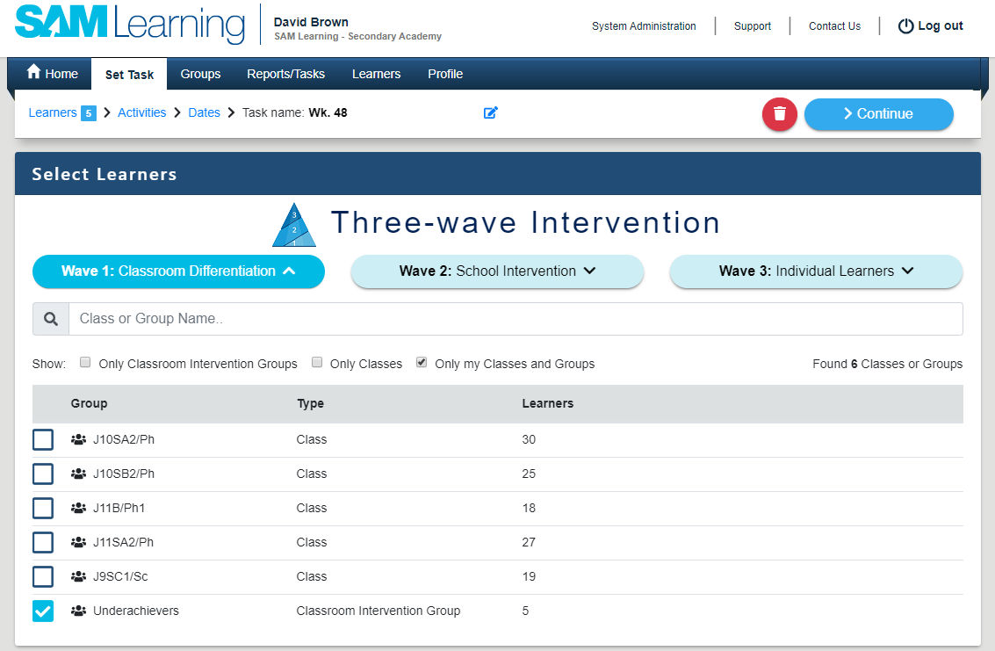
E. Now you can set work to that group
You can monitor their progress on the Reports / Tasks Tab..

Slide 19
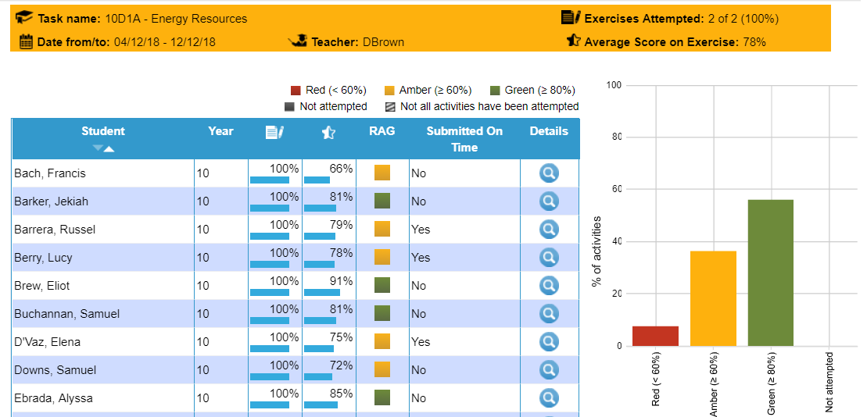
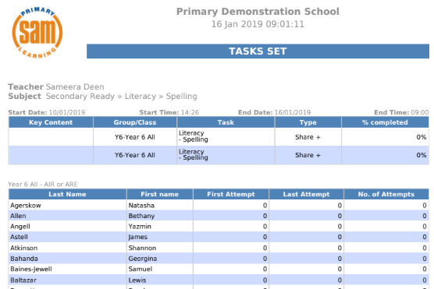
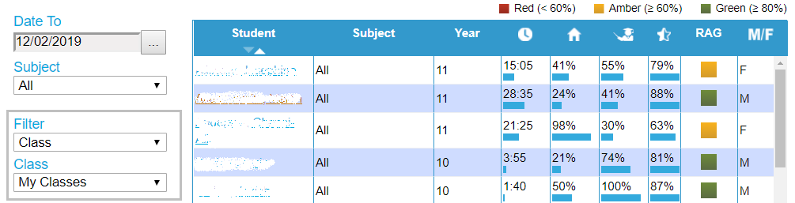
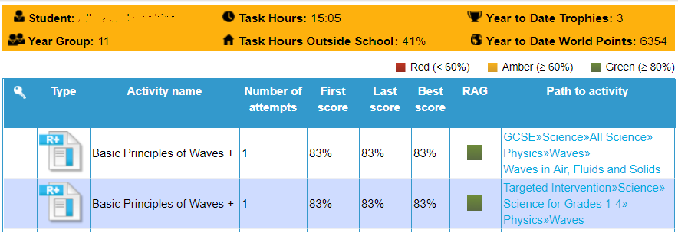
Initial Training
School Success Team
Introduction
Task Types
Creating
Reporting
Groups
How well are my learners doing?
Exit
E-mailed Task Reports
Online Task Reports
Pupil Progress Reports
When a task reaches its end date and time, you can be e-mailed with a report.
You can also review learners’ progress online, at any time.
Get an overview of learners’ progress across all tasks - filtered by group or subject.
Drill down to explore the progress of individual learners.
You can find out who might be struggling - or who hasn’t managed to start a task yet.
It tells you how many attempts each learner took, as well as their percentages.

Slide 20
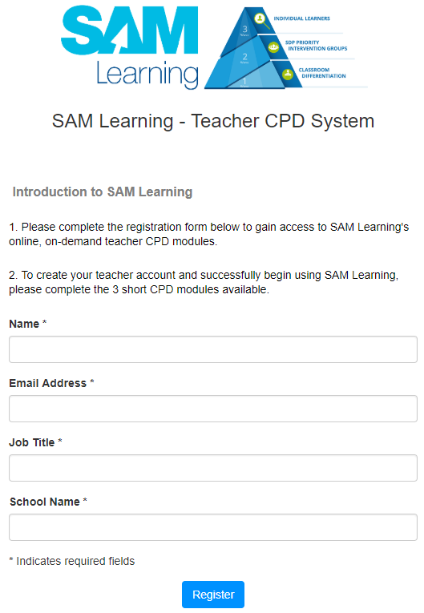
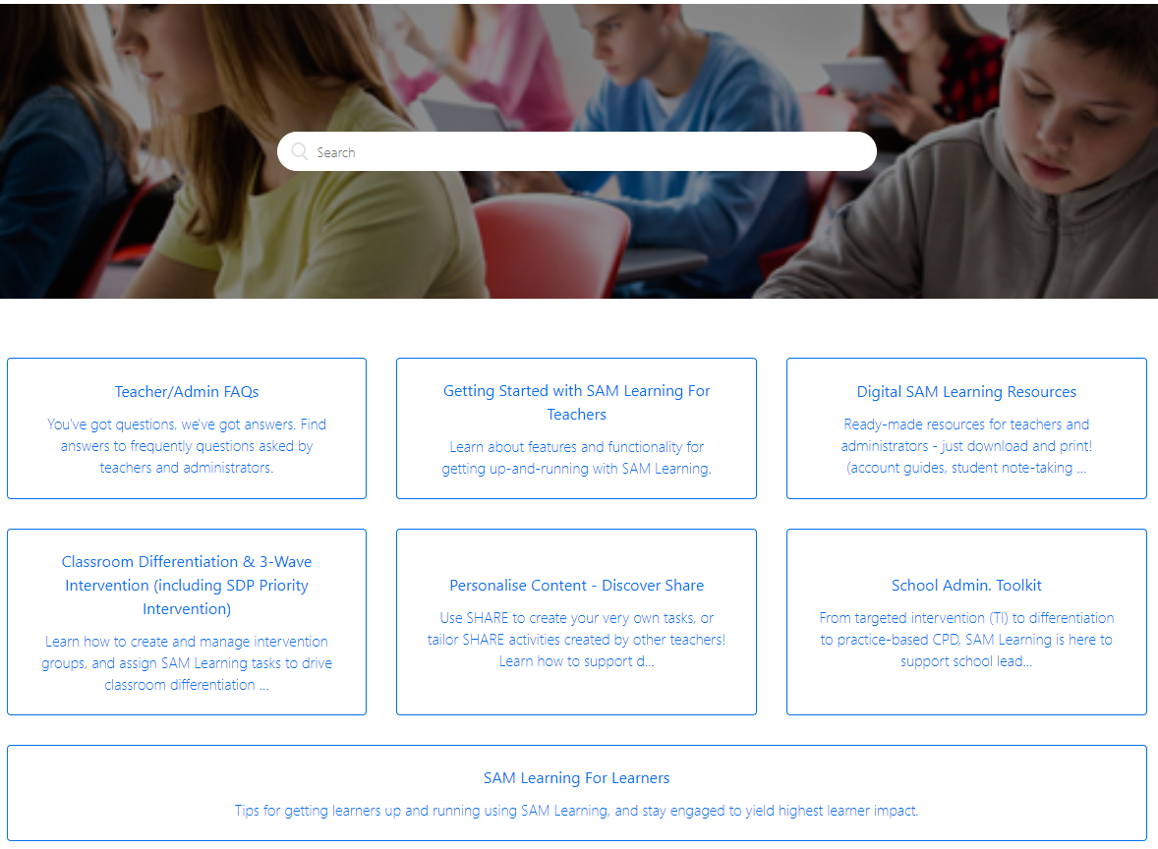
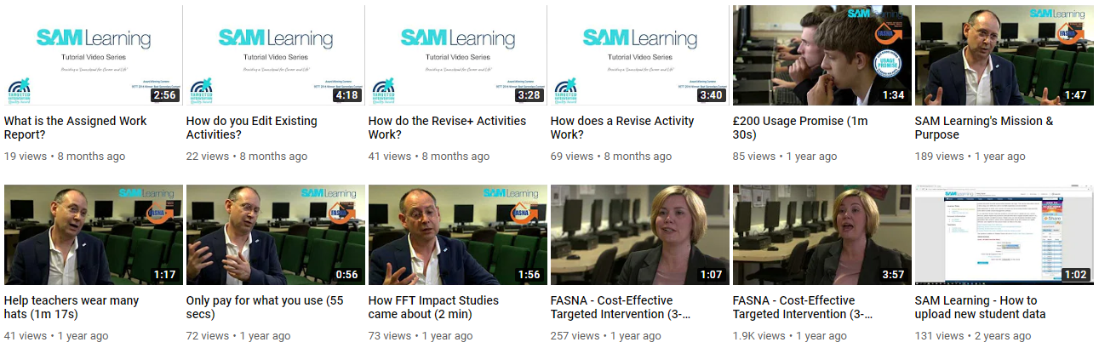
Initial Training
School Success Team
Thank you for working through this training with us, today.
How else can we help you?
Online CPD
Online Support
School Success Team
Articles on our support pages.
Our role is to support you in using SAM Learning - to drive the success of your learners
David Brown
dbrown@samlearning.com
Neil McKie
nmckie@samlearning.com
Videos on You Tube.
Return to Start

